Slide 1

Black Music Player

Slide 2

Group Members
Our team is dedicated to create some Amazing Project for Our Batch and Our fellow Classmate. So with That let me Introduce you to team.
Muhammad Haseeb Ahmed
Mohammad Abdul Rafay
Hamza Tariq
Saif Akhtar.

Slide 3

Black Music Player

Slide 4
Introduction:
Insert the Song
Delete The Song
Sort The song
DISPLAY ANY SONG

Slide 5
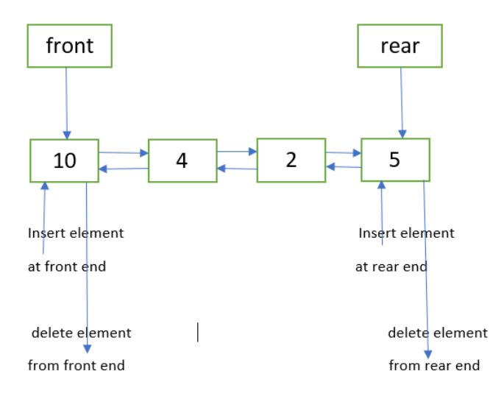
Data Structure
The Data Structure we have used in this Application is The double handle priority queue.

Slide 6
Total Checks in the System
There are a lot of check for the user and that will allow the user to prevent the user to enter the wrong value in to the system
There are Total 7 Check in our System that will enhance the user Experience.

Slide 7
List of Different Functions
Insert()
CheckDID()
Delete_Song()
Display_forward()
Display_Reverse()
Menu()
Sending_Data()
Condition_Checker()

Slide 8
Run Application

